Slide 1
AI CHURN MODEL CHALLENGE​
PREDICTING CUSTOMER CHURN WITH MACHINE LEARNING​
PRESENTED BY: MAHMOUD ALY​

Slide 2
Project Overview and Objectives
Project Overview:
Predict customer churn for a telecommunications company using machine learning.
Objectives:
Conduct Exploratory Data Analysis (EDA) to understand the dataset.
Pre-process data to make it suitable for modelling.
Develop a Random Forest model to predict churn.
Evaluate model performance using appropriate metrics.
Reflect on the process, insights, and potential improvements.

Slide 3
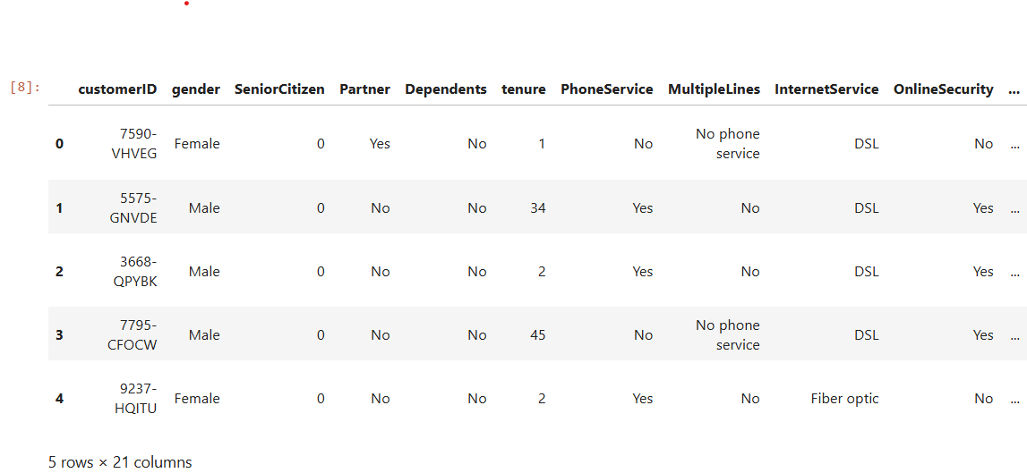
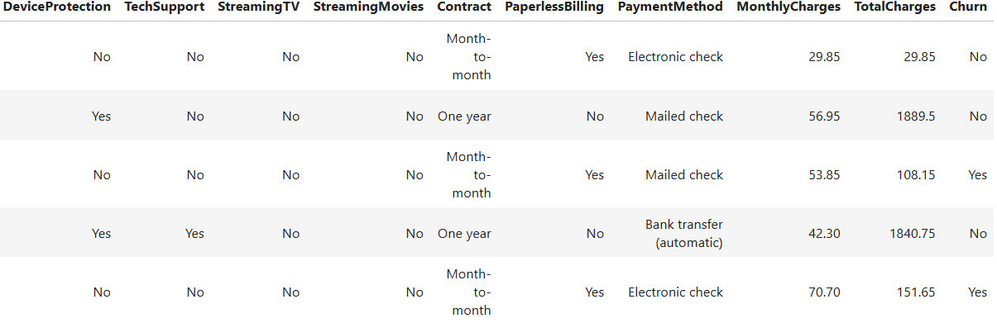
Data Collection
Dataset Source:
The dataset used is the Telco Customer Churn dataset from Kaggle.
Dataset Description:
Contains information about customer demographics, account details, and services availed.
The target variable is "Churn", indicating whether the customer has left the company.
Key Features:
Customer ID: Unique identifier for each customer.
Demographic information: Gender, SeniorCitizen, Partner, Dependents.
Service information: Phone Service, Multiple Lines, Internet Service, Online Security, etc.
Account information: Contract type, Paperless Billing, Payment Method, Monthly Charges, Total Charges.

Slide 4
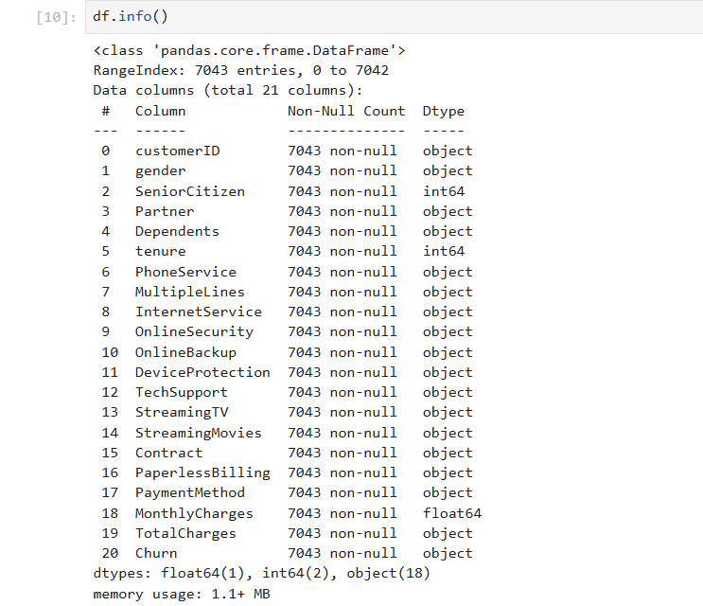
Data Understanding
Gain a comprehensive understanding of the dataset.
Identify key patterns and relationships within the data.
Analyse the distribution of key features such as gender, senior citizen status, partner status, and dependents.
Examine the distribution of churn within the dataset.
Investigate the relationship between services used (Internet Service, Tech Support, etc.) and churn.

Slide 5
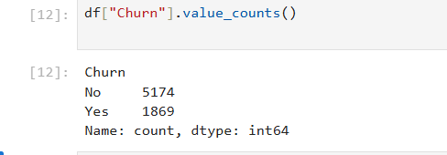
‘Imbalanced Classification Problem
The dataset shows 5174 customers did not churn and 1869 did, highlighting an imbalanced classification problem. This means the model may be biased toward predicting the majority class (No churn). Techniques like SMOTE for oversampling or using algorithms like Random Forest can help address this imbalance.

Slide 6
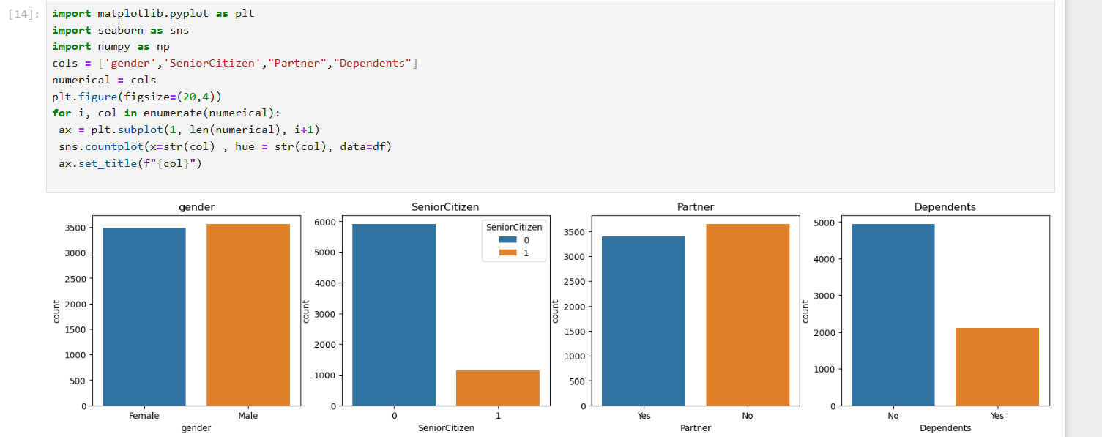
analysis of the demographic variables
Gender Distribution Approximately equal distribution between males and females (3543 males and 3500 females), indicating a balanced representation in the dataset.
Senior Citizen Status Majority are non-senior citizens (5900), with a smaller proportion being senior citizens (1143). This indicates that senior citizens are a minority in the dataset.
Partner Status : More customers do not have a partner (3643) compared to those who do (3400), suggesting that a significant portion of the customer base is single or not in a partnership.
Dependents Status: The majority of customers do not have dependents (4900), while a smaller portion have dependents (2143). This highlights that many customers may not have familial responsibilities impacting their service needs.

Slide 7
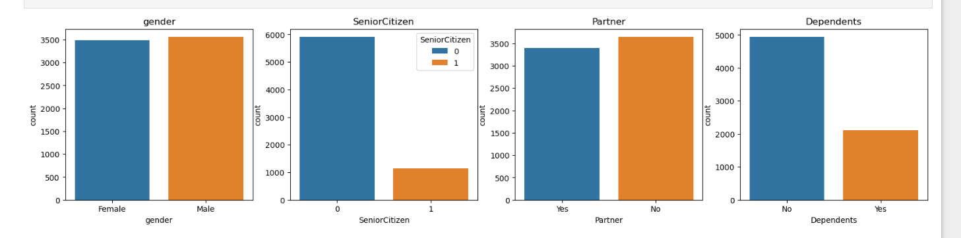
The importance of demographical Analysis
Targeted Marketing: Companies can tailor their marketing strategies based on demographic segments. For example, promotions or services can be customized for senior citizens or customers with dependents.
Service Personalization: Insights into demographics can help in personalizing customer service experiences. For instance, understanding that a customer is a senior citizen might prompt agents to offer more assistance or specialized
-Churn Prediction Demographic variables often influence customer churn behavior. Analyzing these distributions can provide insights into which customer segments are more likely to churn, enabling proactive retention strategies.

Slide 8
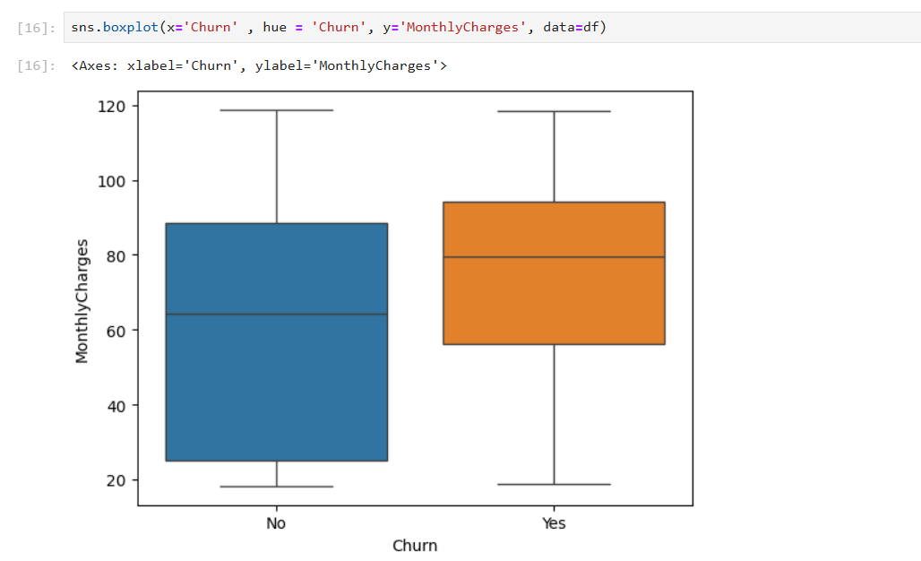
Relationship between cost and customer churn
Analysis of Box Plot: Customer Churn vs. Monthly Charges
Churned Customers (Yes): The middle value of monthly charges is higher.
Non-Churned Customers (No): The middle value is lower.
Churned Customers: The range where most of their charges fall is smaller. This means their monthly charges are closer together and generally higher.
Non-Churned Customers: The range is wider, showing more variation in their charges.
Both groups have charges ranging from about $20 to $120.
Churned customers have more extreme high charges.

Slide 9
The importance of relationship analysis between cost and customer churn
Churn Behaviour Higher monthly charges are linked to more customers leaving.
Retention Strategies To keep high-paying customers, consider offering discounts or extra benefits.
Pricing Strategy**: Balance pricing to keep customers happy and reduce churn
The plot supports the idea that customers with higher charges are more likely to leave.
Conclusion: Customers with higher monthly charges are more likely to churn. This information can help businesses improve customer retention by adjusting pricing or offering special deals to those with higher charges.

Slide 10
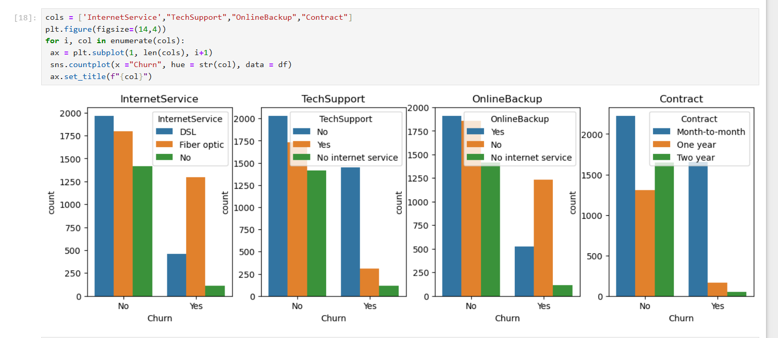
Identify services with higher churn
Hypothesis 1 : Customers with Fiber optic internet service have a higher churn rate compared to those with DSL.
Hypothesis 2: Customers who do not have tech support are more likely to churn than those who do.
Hypothesis 3: Month-to-month contract customers have a higher churn rate than those with one-year or two-year contracts.
Hypothesis 4: Customers without online backup service are more likely to churn compared to those with the service.
Retention Strategies To keep high-paying customers, consider offering discounts or extra benefits.
Retention Strategies To keep high-paying customers, consider offering discounts or extra benefits.
conclusion:
Customers with higher monthly charges are more likely to churn. This information can help businesses improve customer retention by adjusting pricing or offering special deals to those with higher charges.

Slide 11
Data Preprocessing
Purpose:
Prepare the data for modelling by cleaning and transforming it.
Handling Missing Values:
Address missing values in the dataset to ensure completeness.
Converting Data Types:
Convert Total Charges to numeric and handle any inconsistencies.
Transform categorical variables into numeric format using label encoding.

Slide 12
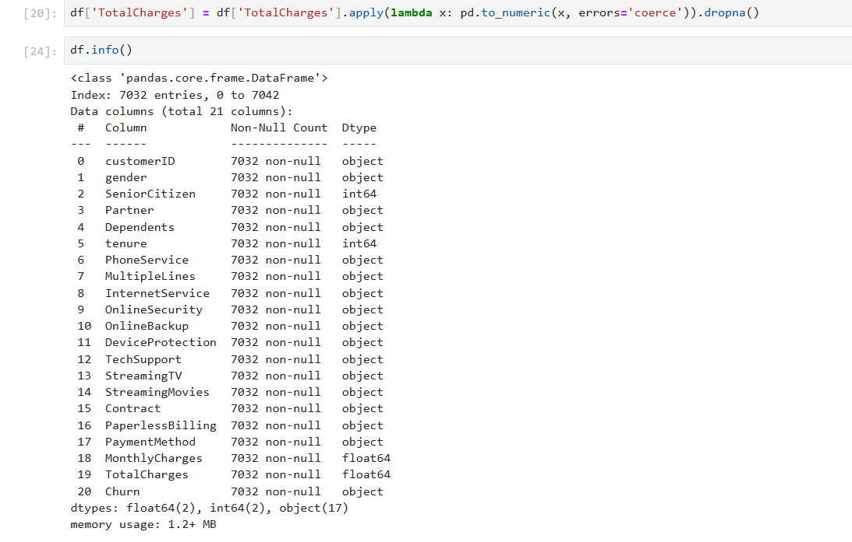
Convert Total Charges column to numeric
The Total Charges column should be converted from object to float64 to correctly represent the numerical data it contains.

Slide 13
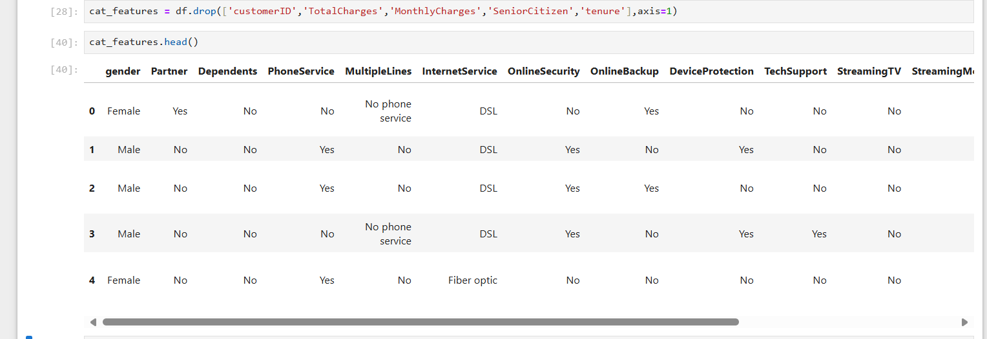
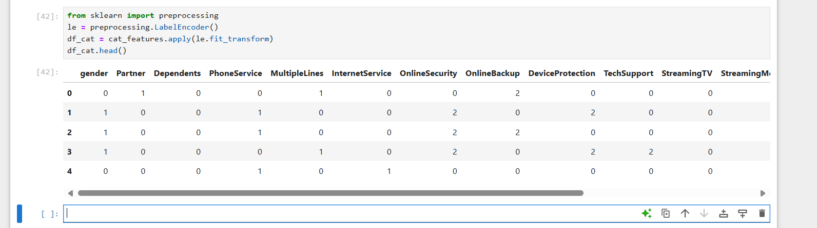
Convert the categorical values to numeric
We will create a Data Frame containing only the categorical variables from your original dataset df.
We will exclude columns like customerID, TotalCharges, MonthlyCharges, SeniorCitizen, and tenure, as these are either identifiers or numeric variables.
Convert categorical values to numeric
Random Forest and Numeric Variables: Random Forest, like many machine learning algorithms, requires numeric input data. This is because algorithms perform mathematical operation
it has been encoded into a format that can be understood and processed by the model

Slide 14
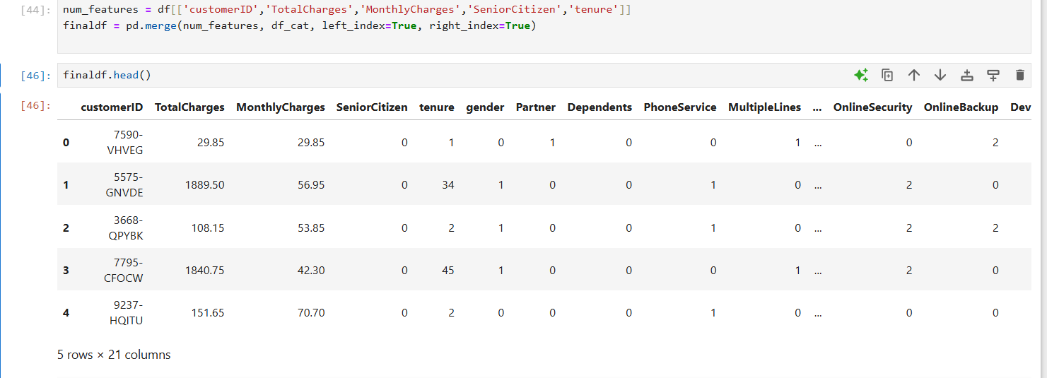
Merge the data frames back together.
Merging datasets is crucial in data analysis as it allows combining information from different sources or different aspects of the same data. In this case, merging helped to integrate numerical and categorical data into a single DataFrame, enabling a more comprehensive analysis of customer attributes and their relationship with churn behavior. This consolidated view is essential for building predictive models and extracting actionable insights to improve customer retention strategies.

Slide 15
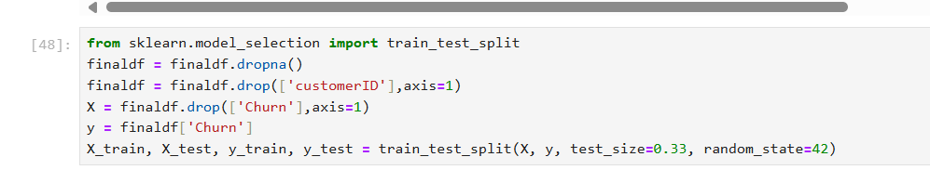
Model Training
splitting the dataset
Imported train_test_split: This function from sklearn.model_selection helps split data into training and testing sets.
Handling Missing Values: Removed rows with missing data using dropna()
Removing Unnecessary Column: Dropped the 'customerID' column from finaldf using drop(['customerID'], axis=1)
Defining Features and Target: Created X (features, all columns except 'Churn') and y (target, 'Churn' column).
test_size=0.33: Reserved 33% of the data for testing.
random_state=42: Set a seed for randomization to ensure reproducibility.

Slide 16
Split the dataset into training and test sets
Splitting the dataset into training and test sets ensures that the model learns from a subset of data (training set) and validates its performance on unseen data (test set).
Training a machine learning model is crucial as it allows the algorithm to learn patterns from historical data, enabling predictions on new, unseen data.
Predicting churn (Churn) helps businesses understand customer behavior and take proactive measures to retain customers.

Slide 17
Oversample the training data
Initially, we noticed that the dataset has a bias or imbalance, where one class (in this case, churned customers) is underrepresented compared to the other class (non-churned customers)
This imbalance can cause machine learning models to be biased towards the majority class, ignoring the minority class (churned customers)
Oversampling involves increasing the number of instances in the minority class (churned customers) to balance it with the majority class (non-churned customers). This is done by creating synthetic examples based on existing minority class examples.

Slide 18
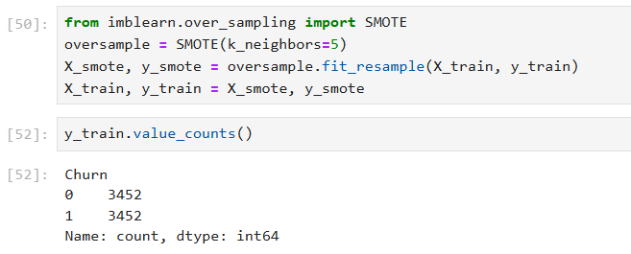
Synthetic Minority Over-sampling Technique
SMOTE is a popular method in machine learning that generates synthetic samples by interpolating between existing minority class samples.
k_neighbors=5 specifies how many nearest neighbors to use when generating these synthetic samples.
sampling bias where the dataset used may not represent the entire customer population accurately
evaluate model performance, ensuring it aligns with business objectives and ethical standards. Regular monitoring and iterative refinement are essential to mitigate biases and improve model accuracy and fairness.

Slide 19
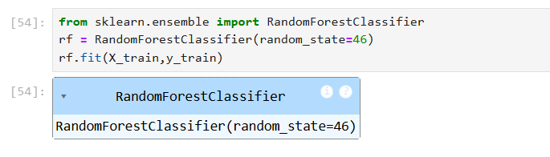
Train the Random Forest model
Train a Random Forest model on the balanced dataset

Slide 20
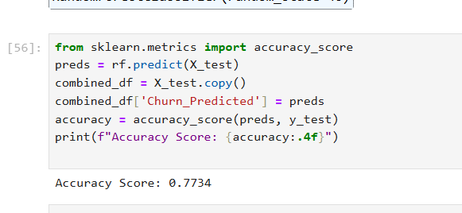
Accuracy measures
how well the model's predictions match the actual outcomes.
If the model correctly predicts 773 out of 1000 customers' churn status, the accuracy is 77.3%.
Accuracy provides a straightforward way to evaluate the model's performance.
It helps in understanding the proportion of correct predictions out of all predictions made by the model.
Accuracy alone may not be sufficient, especially in imbalanced datasets where the number of instances in different classes varies significantly. Other metrics like precision, recall, and F1-score should also be considered for a comprehensive evaluation.
The accuracy score of our Random Forest model is 0.7734, meaning the model correctly predicted customer churn 77.34% of the time.

Slide 21
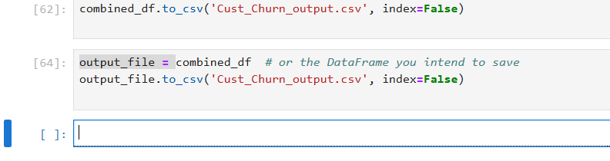
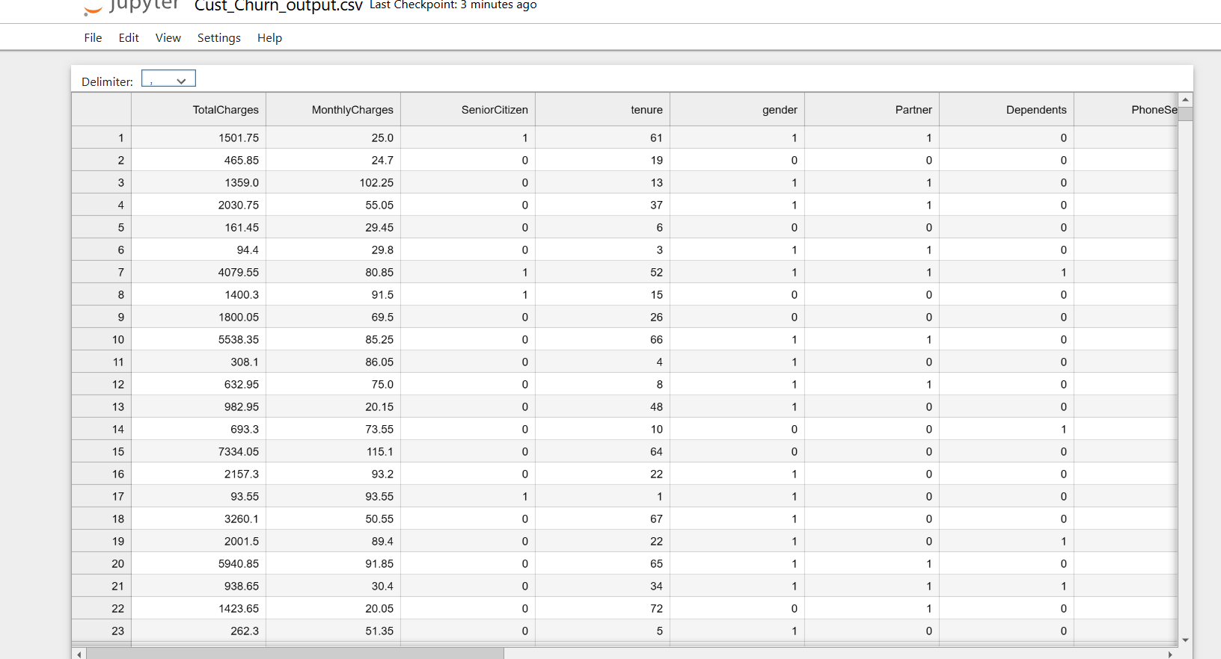
exporting merged file
output_file is not defined as a DataFrame
saving the DataFrame (table of data) into a CSV file
combined_df is a DataFrame that combines the test data with the model's predictions

Slide 22
Reflections and Learnings
Importance of data cleaning and preprocessing for accurate model predictions.
Techniques for handling missing values and converting data types.
Gained insights into data through visualizations.
Identified key patterns and relationships influencing customer churn.
Trained a Random Forest model and addressed class imbalance using SMOTE.
Evaluated model performance with accuracy scores and other metrics.
Effectively used libraries like Pandas, Seaborn, and Scikit-Learn for data analysis and modeling.

Slide 23
Importance and Business Applications
Understanding and predicting customer churn helps businesses retain customers by identifying those at risk of leaving.
Reducing churn rates can significantly increase revenue and profitability.
Enables companies to design targeted marketing campaigns and personalized offers to retain at-risk customers.
Helps allocate resources more effectively towards customer retention efforts.
Insights from churn models can help improve service quality and customer satisfaction.
Businesses can address pain points identified through data analysis.
Identify patterns in user behavior that lead to cancellations and improve subscription models accordingly.

Slide 24
Challenges Faced
Interpreting the accuracy value in the context of an imbalanced dataset and realizing its limitations, necessitating the use of additional metrics like precision, recall, and F1-score.
SMOTE generates synthetic samples to address class imbalance and applying it correctly to the training dataset was challenging.

Slide 25
Future Improvements
Stay updated with the latest advancements in machine learning and data science to continually improve the approach and techniques used.
Invest more time in creating and selecting features that could provide better predictive power, including interaction terms and derived features.
Ensuring the model accurately predicts the minority class without being biased towards the majority class.

Slide 26
Career Aspirations
I am passionate about solving complex problems using data-driven insights.
I am dedicated to staying updated with the latest advancements in AI.
AI and data science have the potential to transform industries globally.
I want to leverage AI to create meaningful and positive societal impact.
Using AI to drive business success and improve decision-making processes excites me.
My natural curiosity fuels my desire to explore new AI technologies and methodologies.
Being part of a field that shapes the future of technology is incredibly motivating.

